Slide 1
Level 4/5 Group 4
Tom Simmons
Ben Reynolds
Ionut Ciobanu
Sam Clack

Slide 2
Phantasm
There is no escaping your past.

Slide 3
Plot Summary
The MC will experience a traumatic accident in the opening cut scene
The MC will fall into a coma, and ‘awaken’ in a nightmarish world
The MC’s goal is to escape from this coma and return to reality

Slide 4
Obscure Sorrows

Slide 5
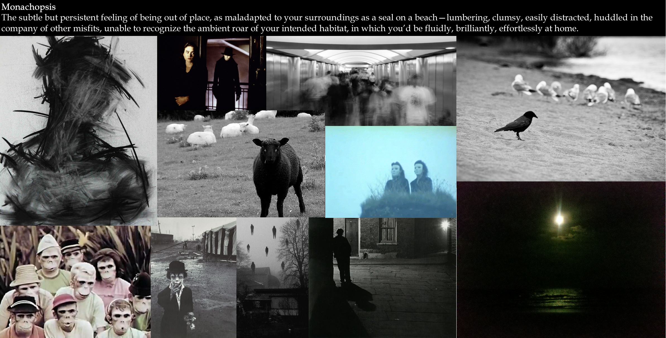

Slide 6
Monachopsis
The Player is thrown into a world that is completely new to him
The world is inhabited by unfamiliar beings
As the game progresses, the MC will notice subtle familiarities as he realises the world is in fact a product of his subconscious

Slide 7
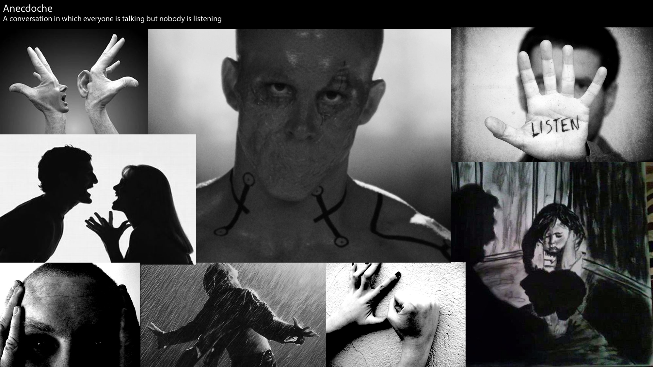

Slide 8
Anecdoche
The Player will hear whispers and muffled talking through the game’s levels.
These audio queues will help guide the Player through the levels and hint at solutions to the game’s puzzles.
The MC will later realise that these voices originate from his surroundings outside of his coma.

Slide 9

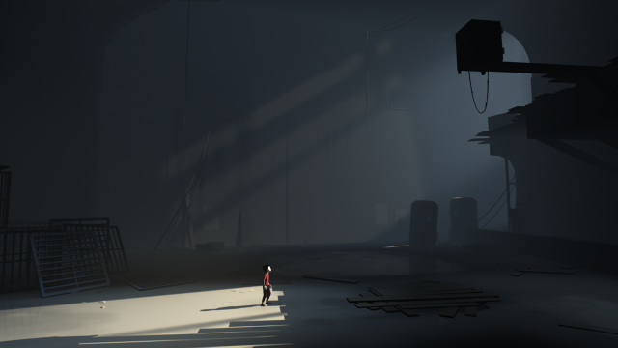
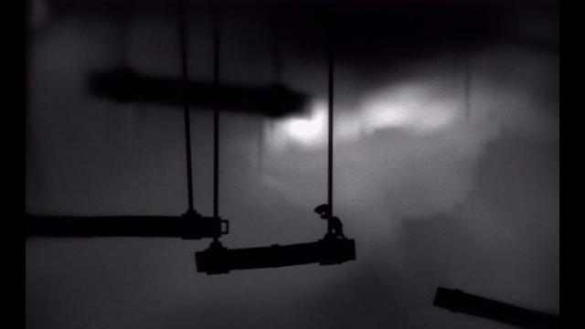
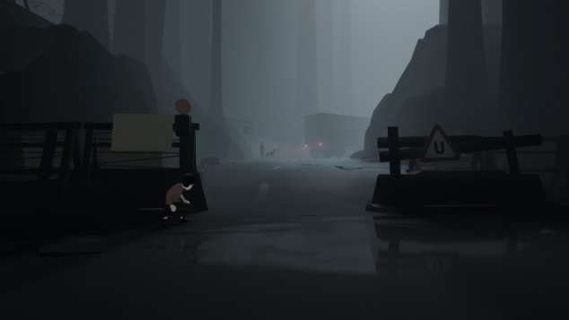
Target Audience
Males & Females
Aged 16-31
2D Puzzle Platformers
Adventure & Mystery
Based on research into games of a similar nature (Limbo/Inside)

Slide 10
Target Platforms
PC
Xbox Arcade
Playstation Store

Slide 11
Game Mechanics
Twitch Movement
Puzzle Solving
Audio Navigation

Slide 12
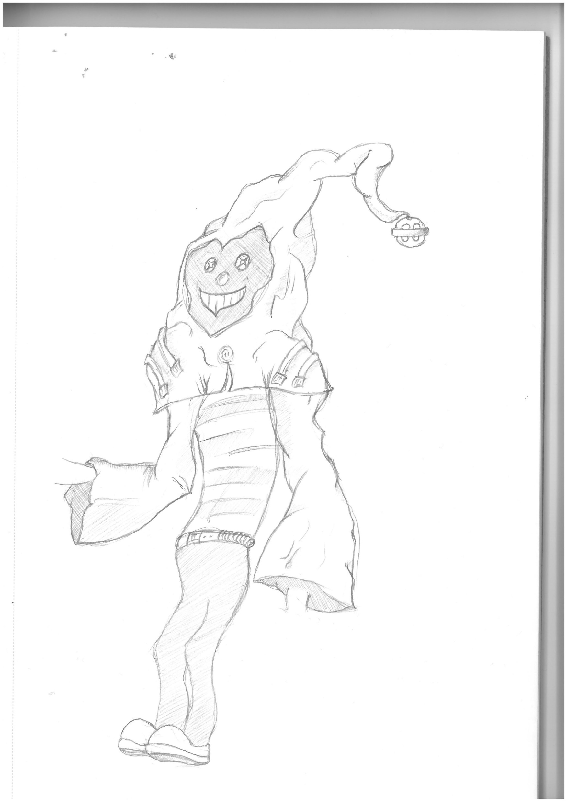
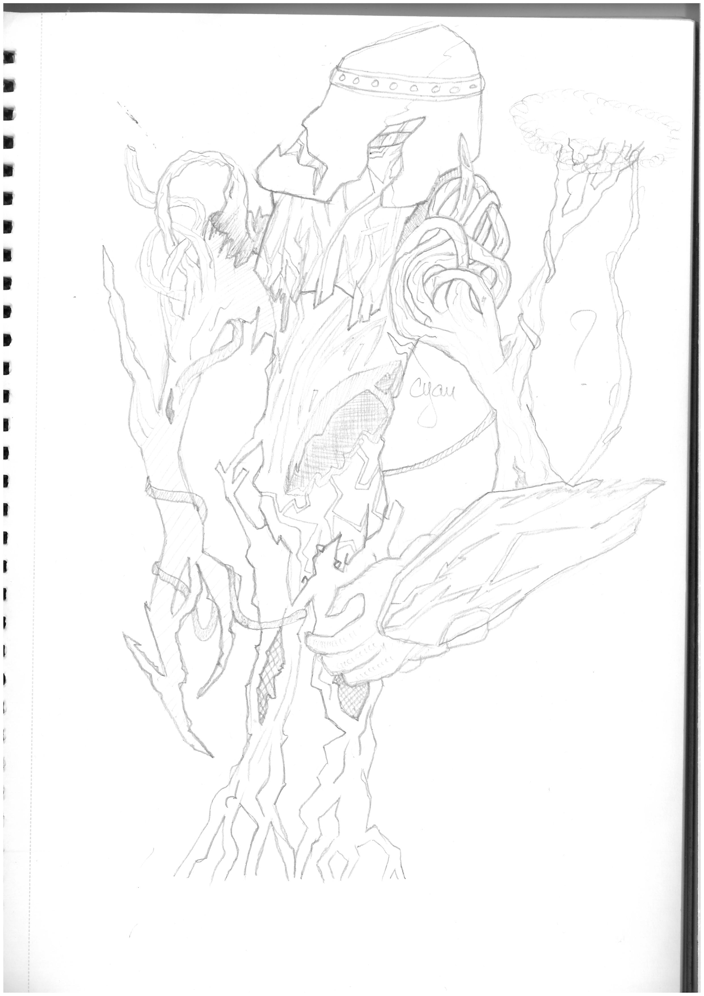
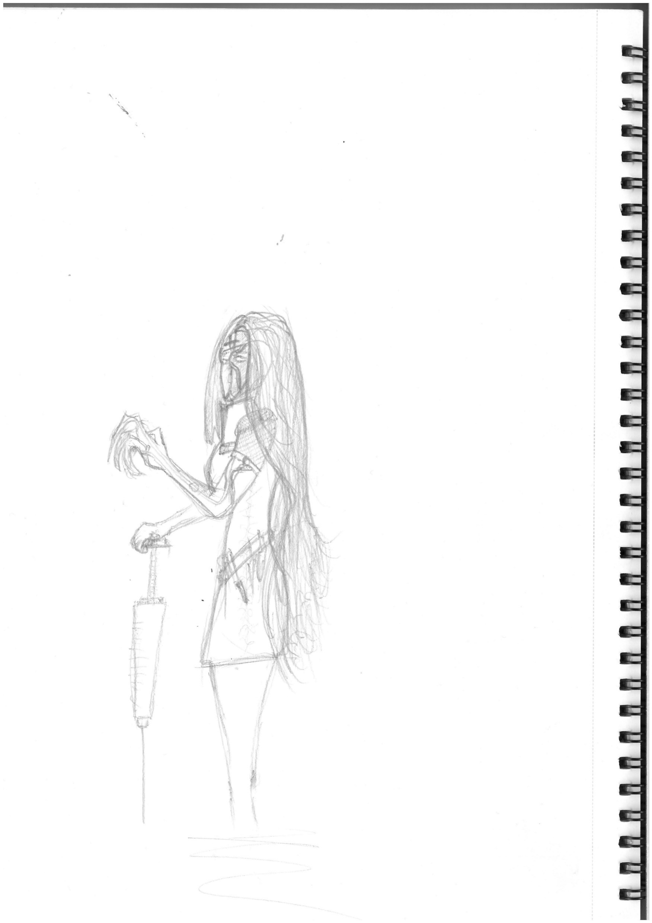
Protagonists

Slide 13
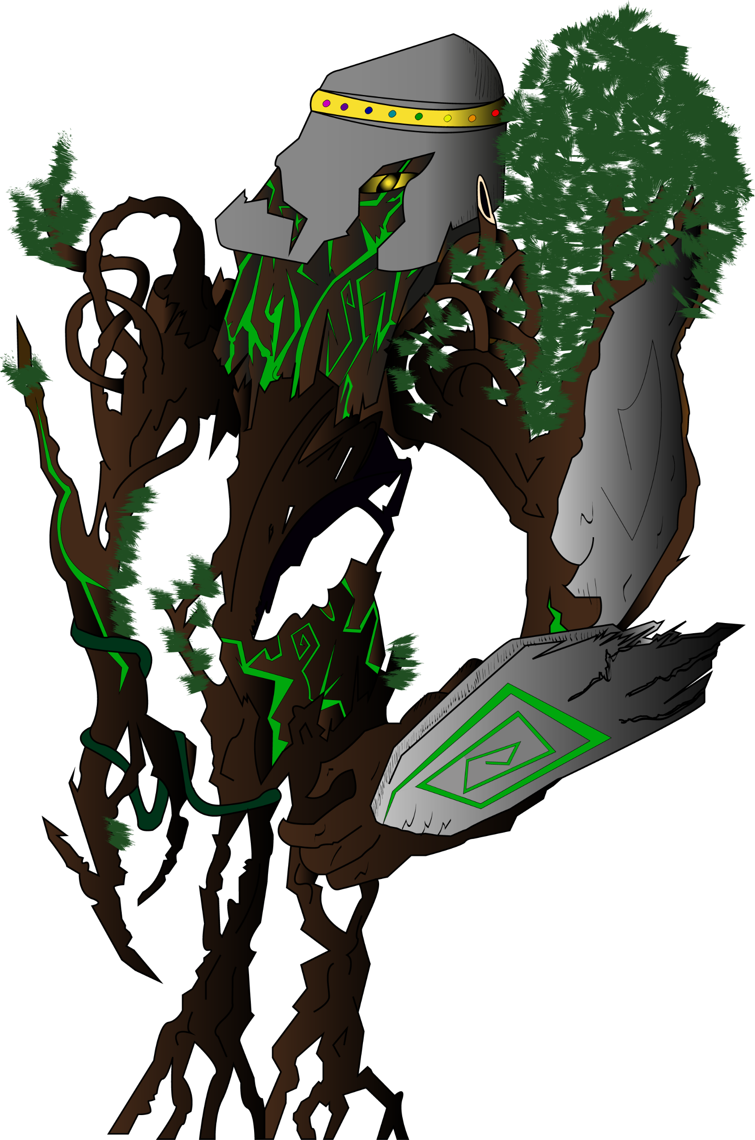
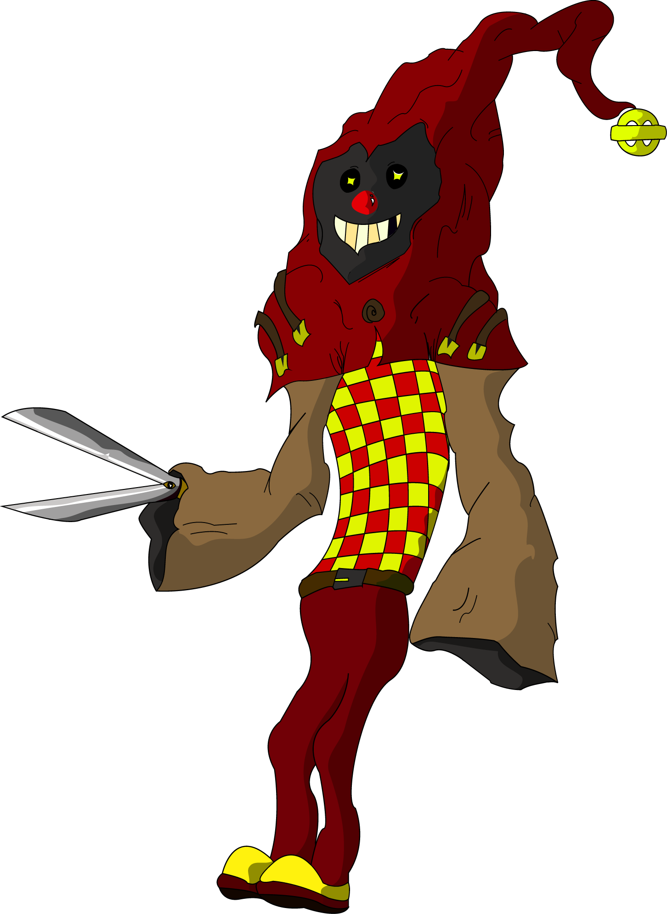
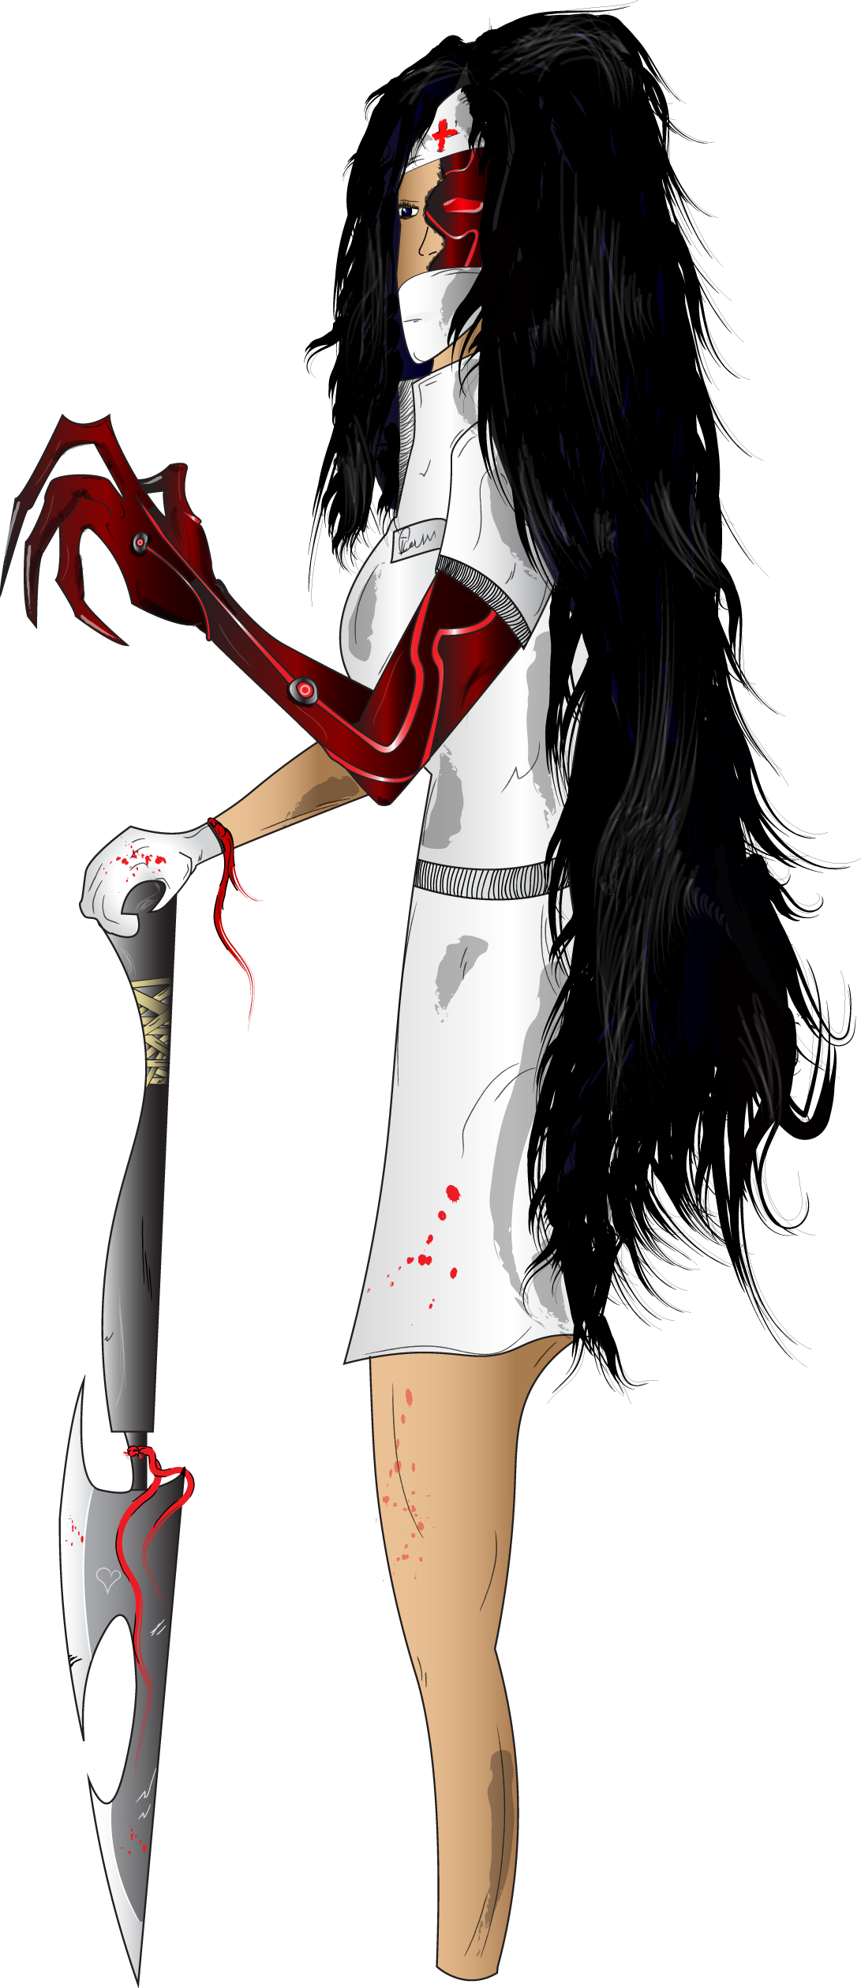
Protagonists

Slide 14







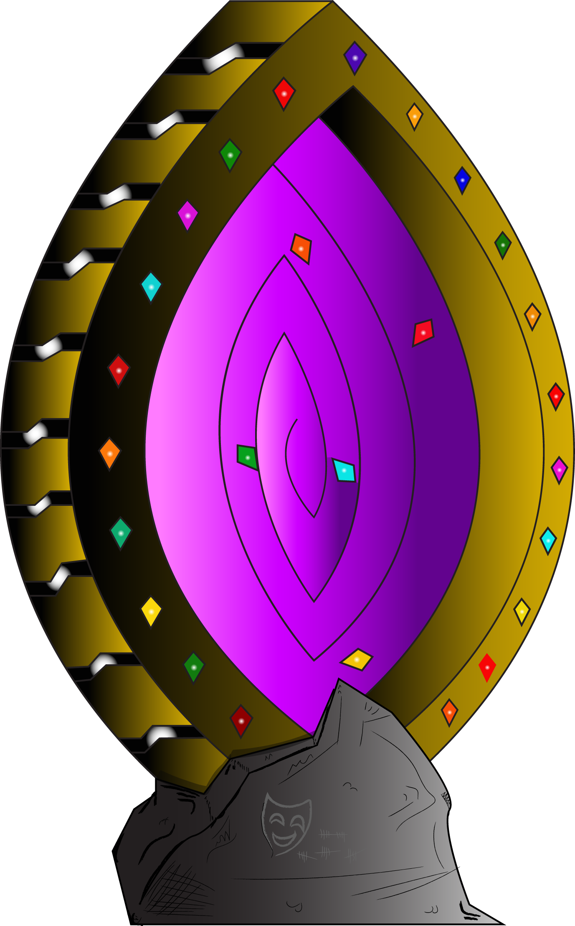
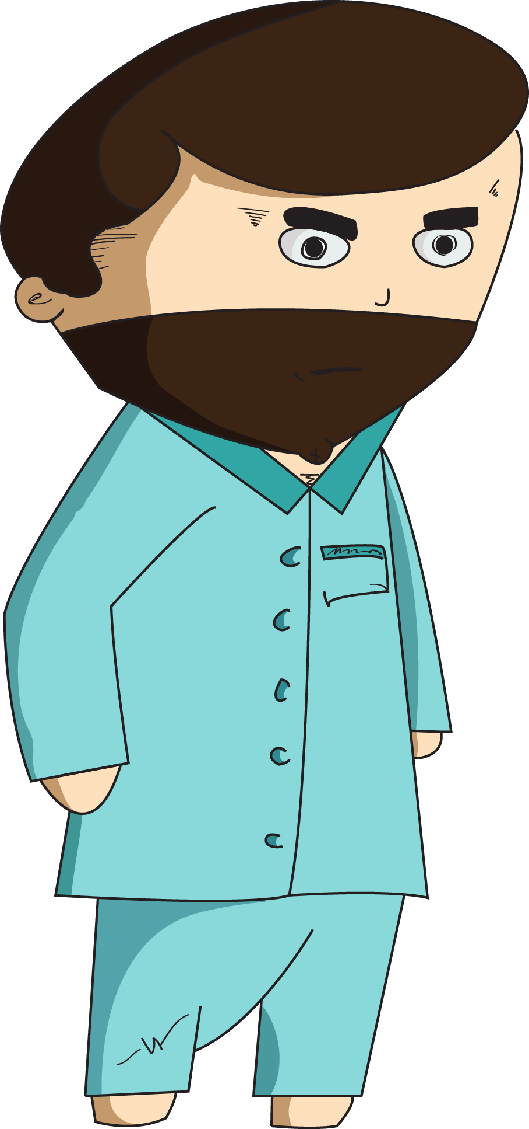

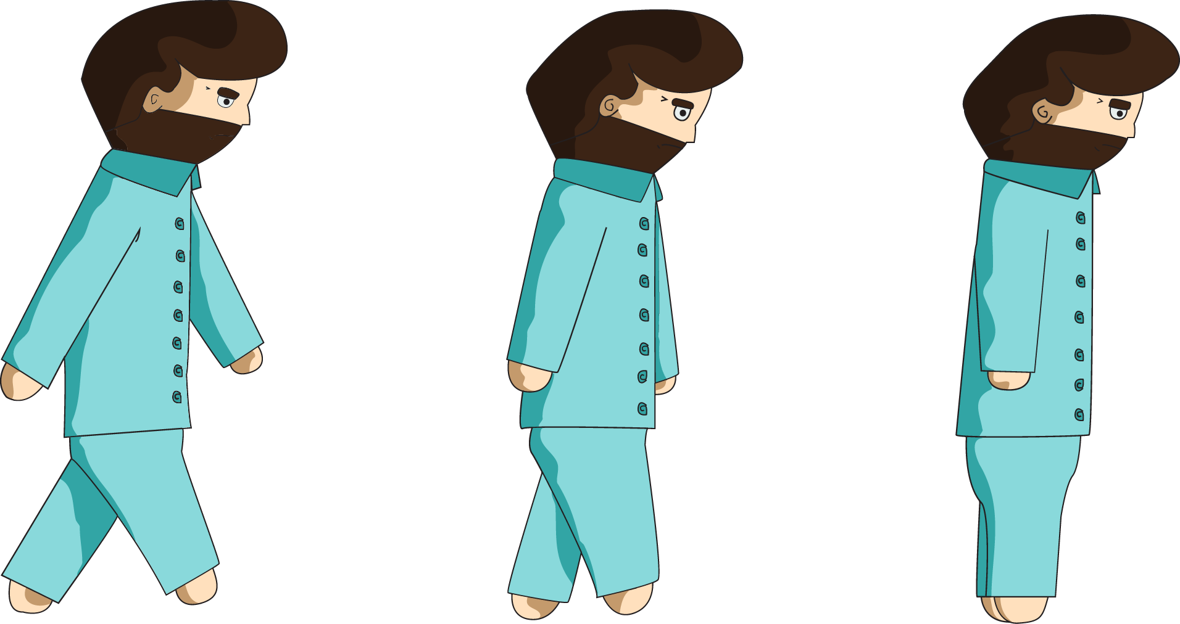

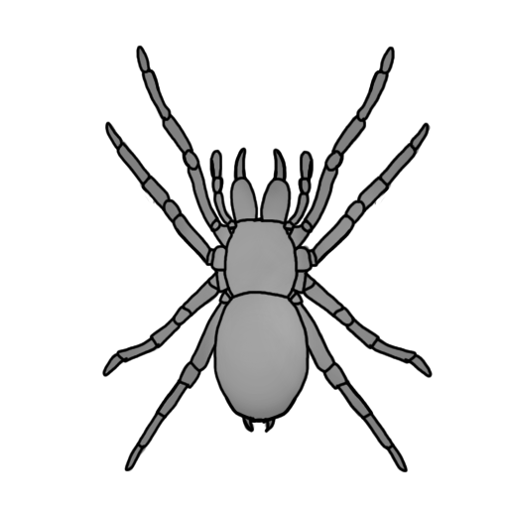
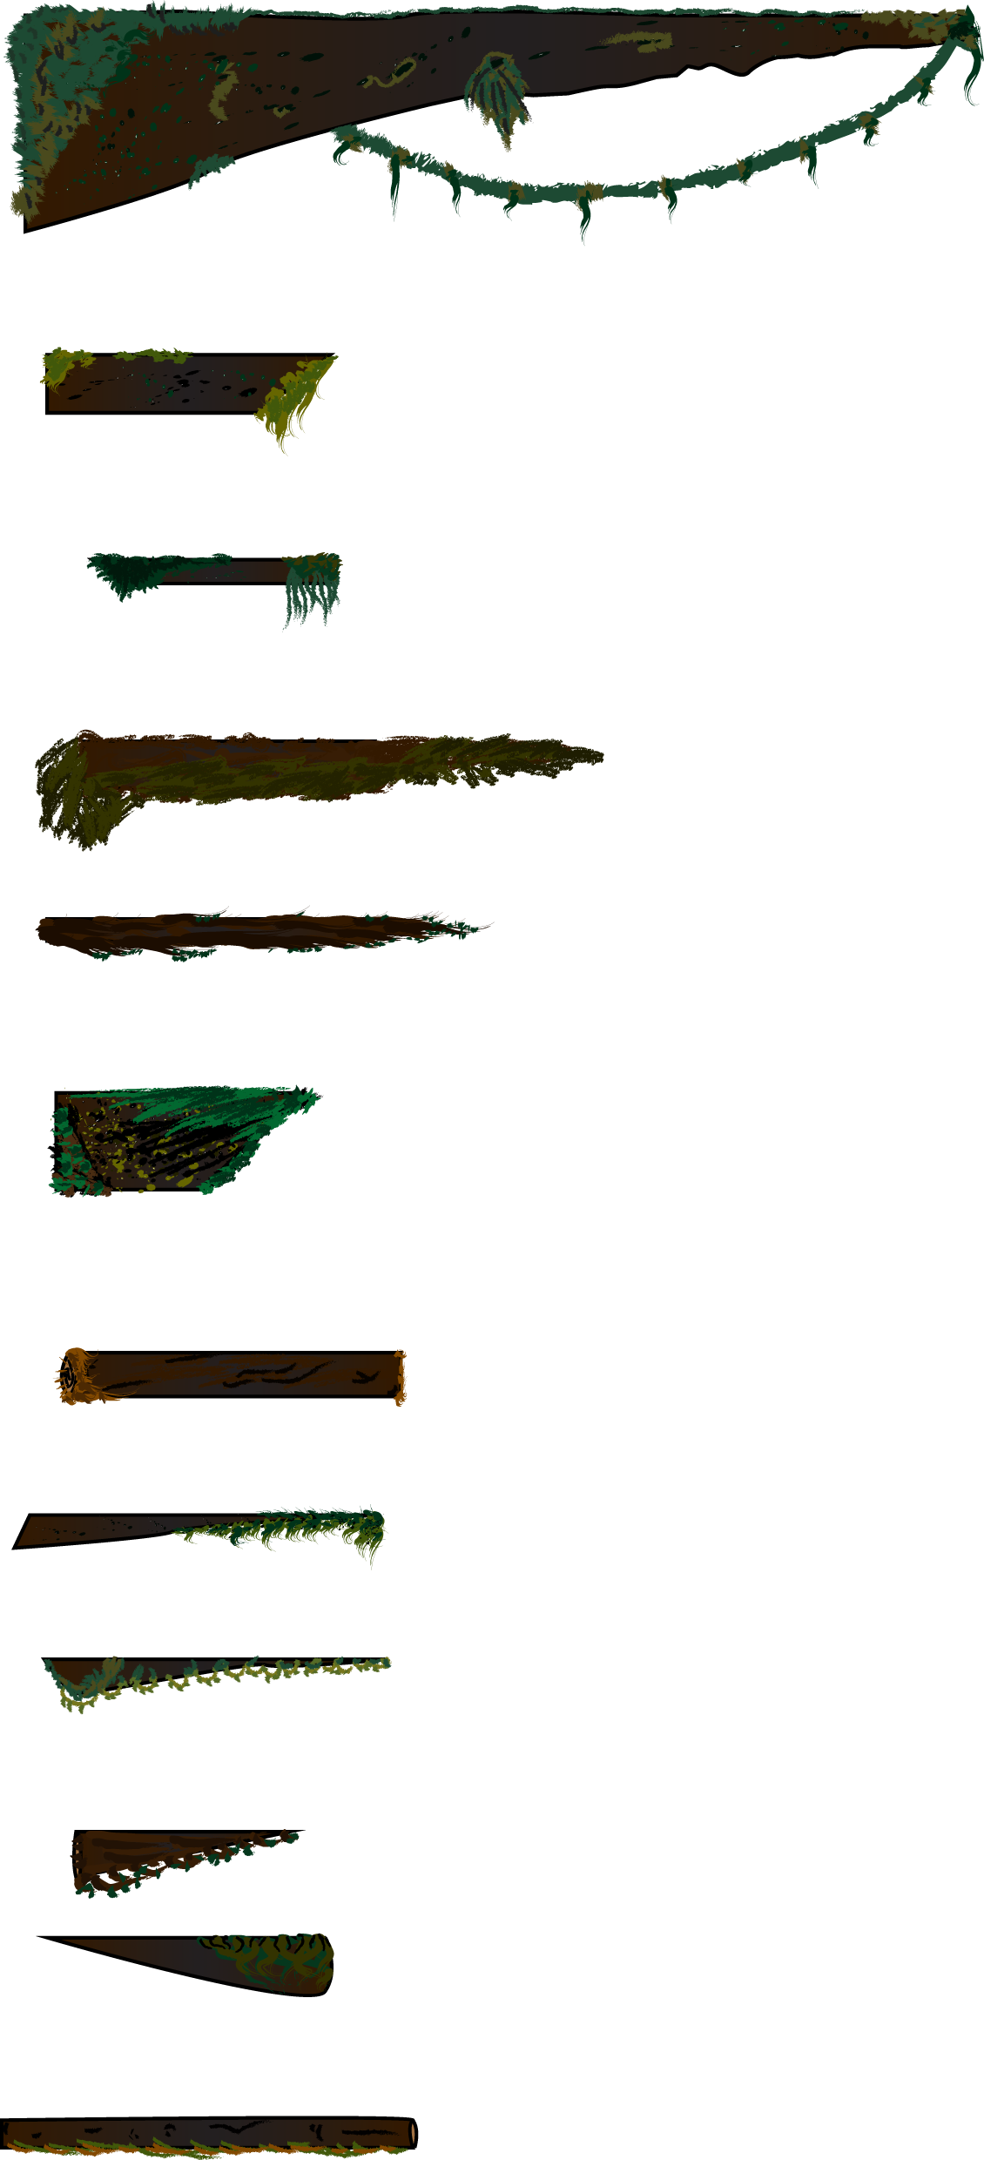




Game Assets

Slide 15
Gameplay Video

Slide 16
_{Management}

Slide 17
Play Testing / Feedback
“Make game menu more colourful and appealing towards the player because its what they’ll first see when opening up your game.”
“Vary some of the platform designs to make the scene more interesting.”
“The Platforms all being idle is somewhat boring and some should move around or disappear.”
“The Mini puzzle game should have the icons flipped over briefly to add the effect of matching the MC’s memories.”

Slide 18
Emails Sent

Slide 19
Hours Logged

Slide 20
GitHub Commits

Slide 21
Lessons Learned

